Slide 1

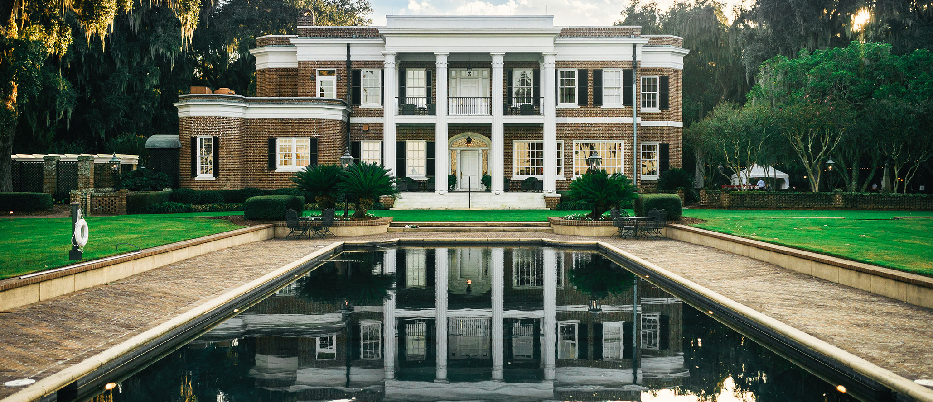
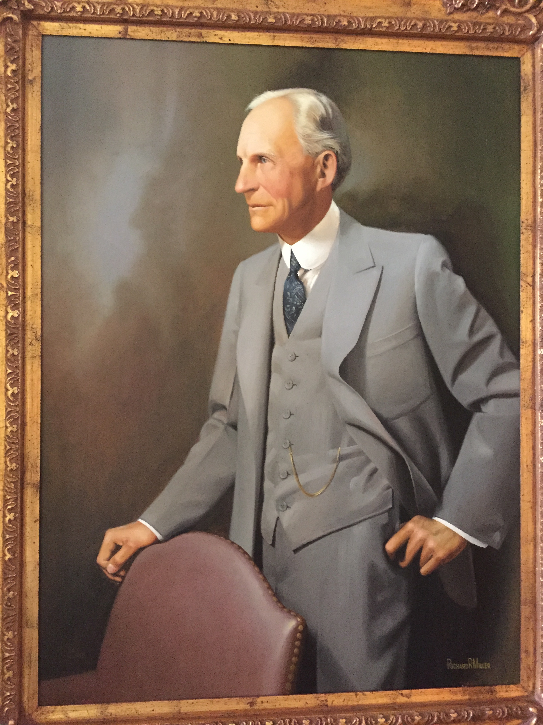
Created by Henry Ford in the 1920’s as his 80,000 acre southern retreat,
the Ford Plantation was introduced in 1998 as an 1,800 acre private residential
“Sporting Club” Community.

Slide 2
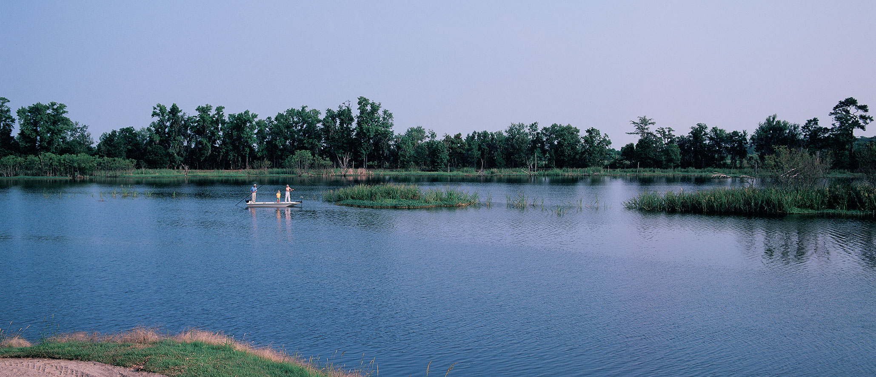
In the late 1990’s with very aggressive marketing dollars, a successful sales launch was conducted by DPS resulting in sales exceeding 60% of the lots offered. However, many of these buyers were investors or “Flippers”. Prices were rapidly raised as many of the investor buyers created a “feeding frenzy”. Most of the investor buyers bought multiple lots to “flip” and
never intended to be end users as Ford residents.

Slide 3
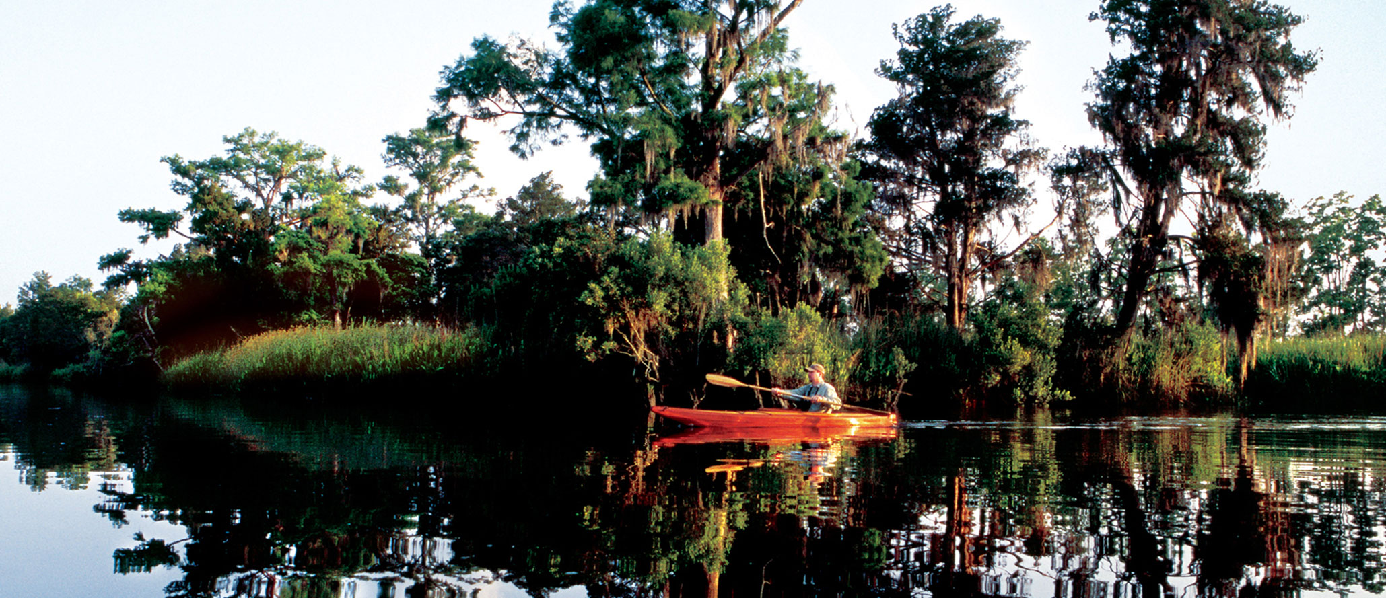
Investors were allowed dormant Memberships. This gave them assurance that buying multiple lots was a good decision.
DPS profited and the initial tranche of funding was paid back.
Sales were successful and on the surface Ford seemed on target.

Slide 4


Some cottages were built around the Clubhouse and some grand Estate Homes. Families began moving in.
Then the dormant Membership period ended and the owners of investment lots who did not want to pay the $22,000 per year HOA wanted to sell or
“flip” their lots as promised.
A large amounts of Investor Lots For Sale inventory began to grow.

Slide 5
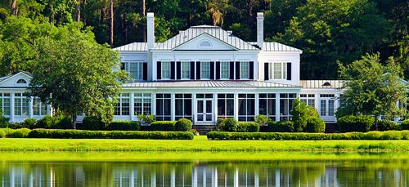
Prices that had been artificially escalated began to fall as investors became desperate to sell! Ford became flooded with inventory. Supply and demand got out of control. DPS along with their highly skilled team of onsite sales professionals left along with their destination resort marketing experts.
A piece meal team remained.
Fast forward to today..

Slide 6
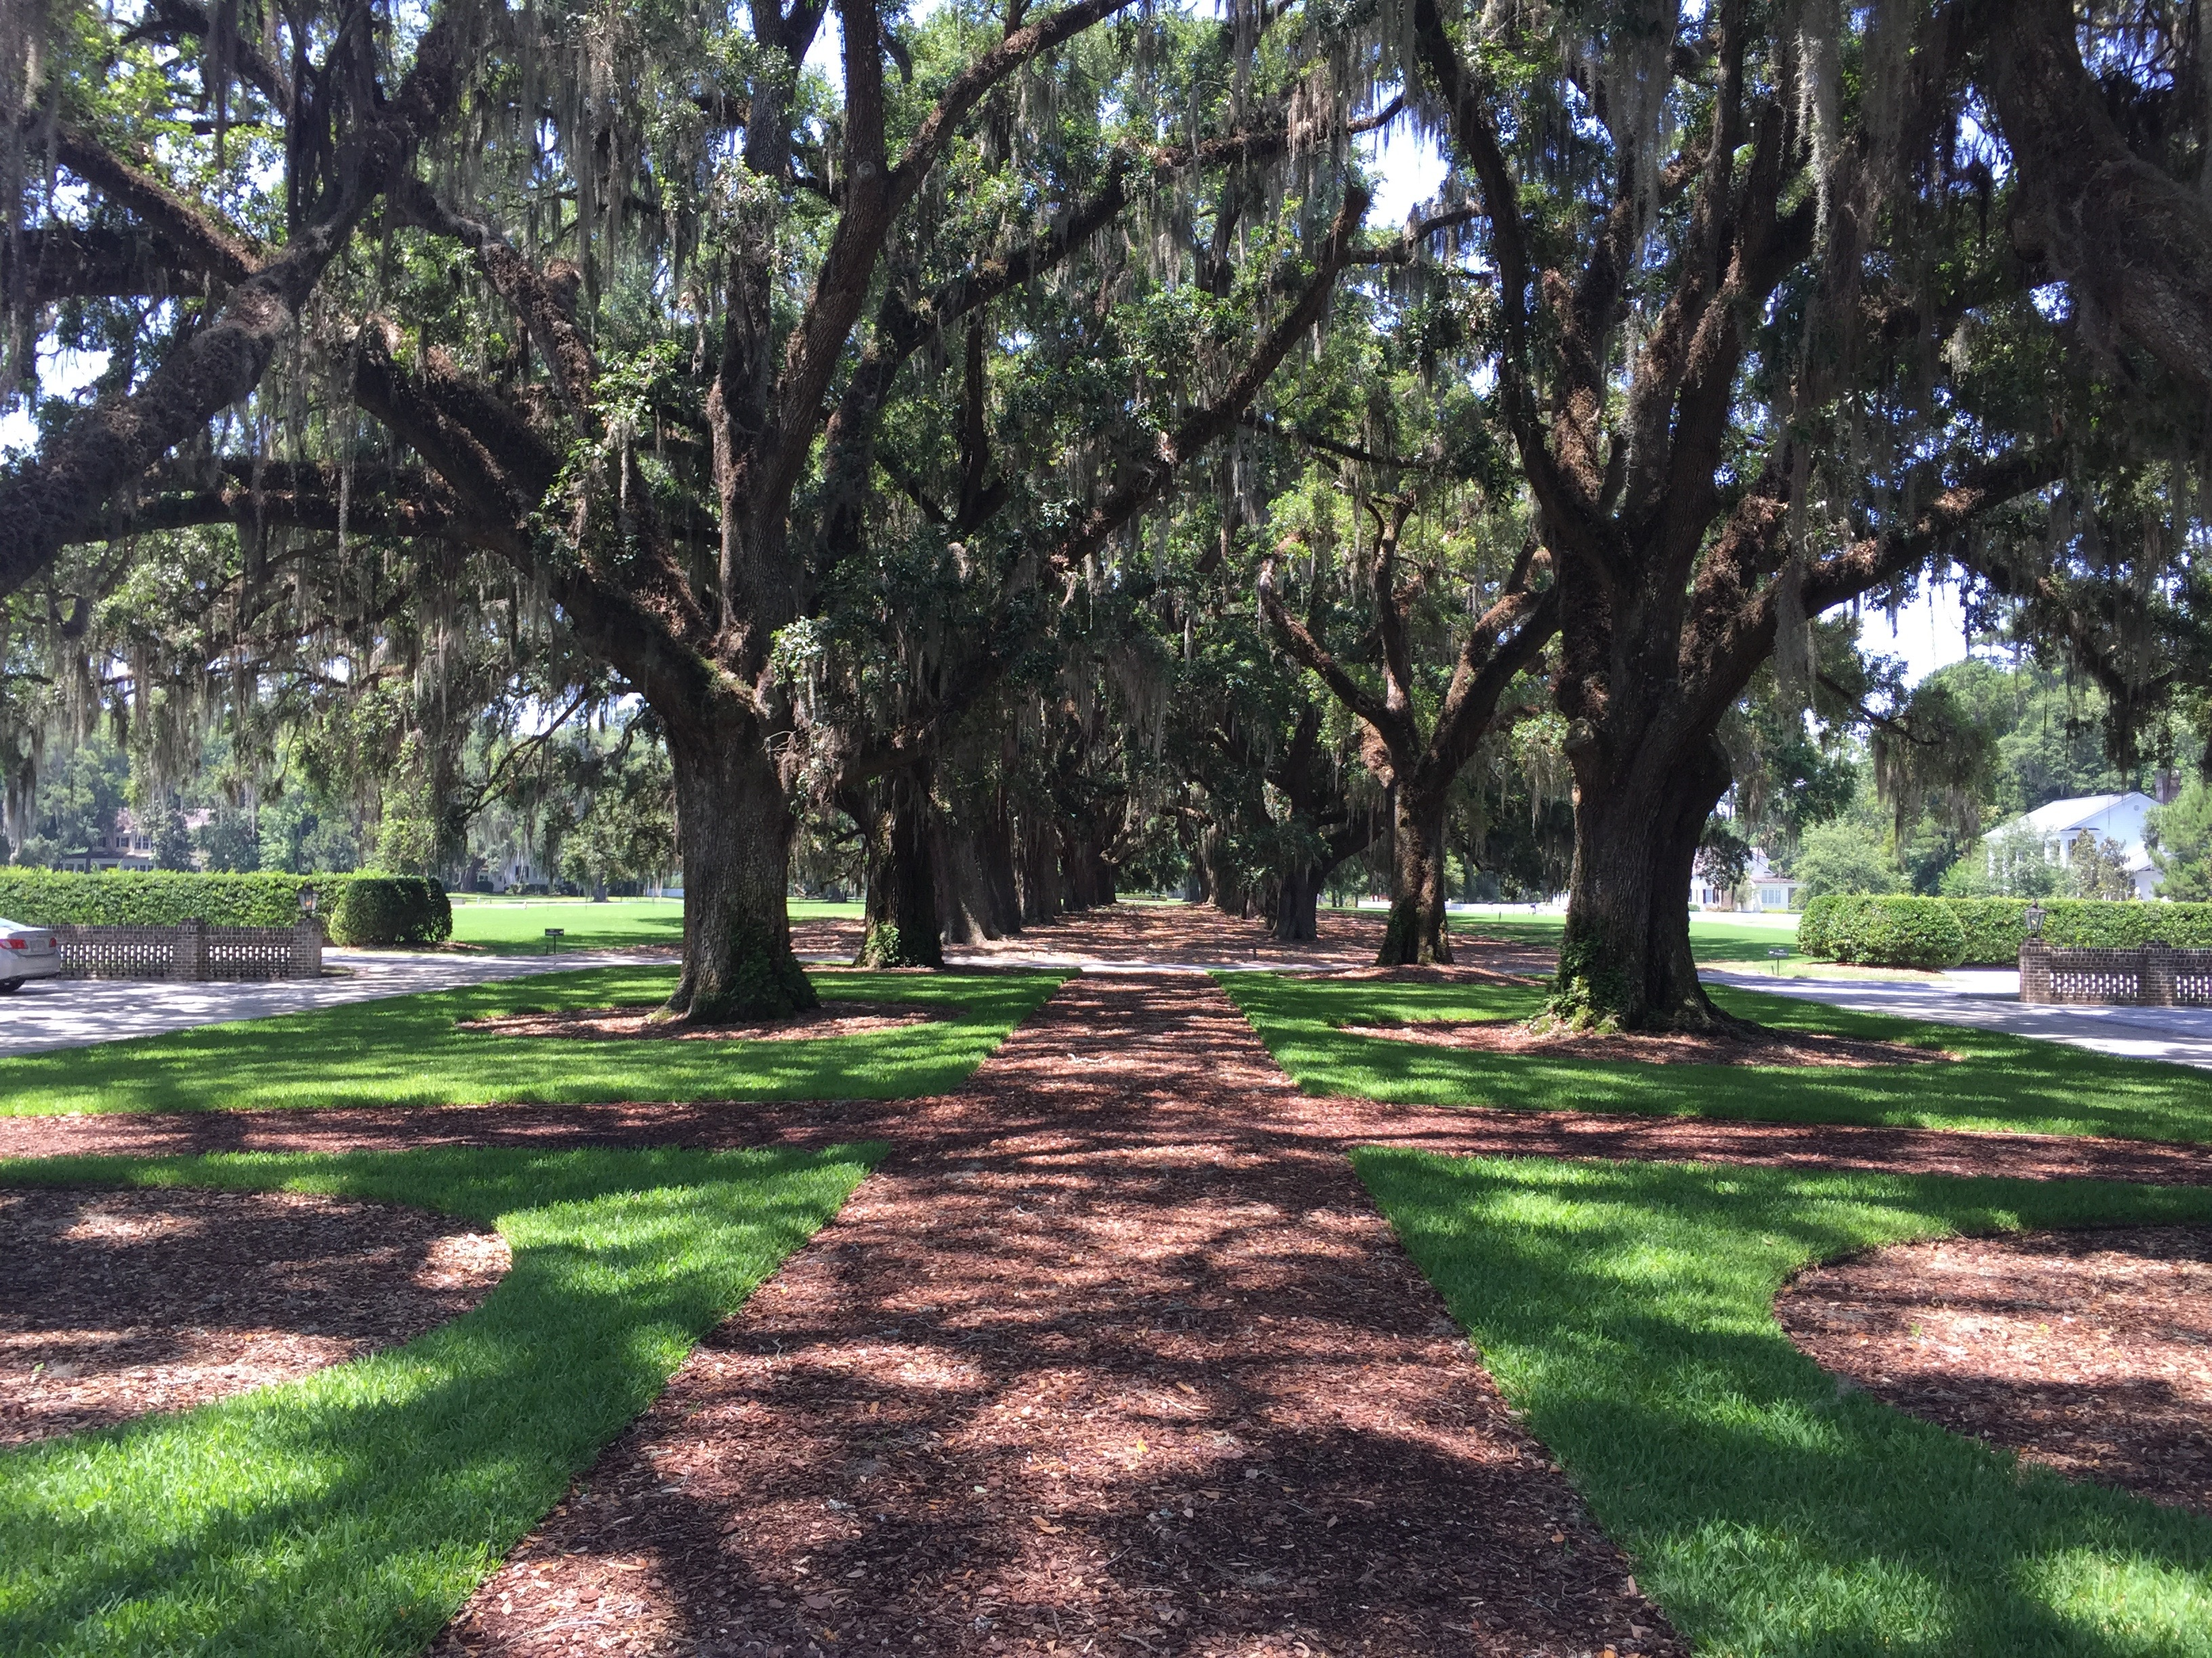
FORD TODAY
PLANTATION
400 lots
177 homes built
126 lots for sale
35 homes for sale
CLUB
252 Members
Initiation fee - $50,000
Dues - $22,000 per year
$8 million in revenues
NOI is barely breakeven

Slide 7
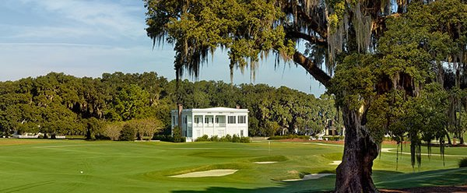
Ford remained damaged with two sales team members, one a previous representative for the original investment team with no luxury community sales or development experience and the other a coastal broker whose main income is generated from sales made outside of Ford using the Ford marketing to generate their prospects but producing no sales or income for Ford.

Slide 8
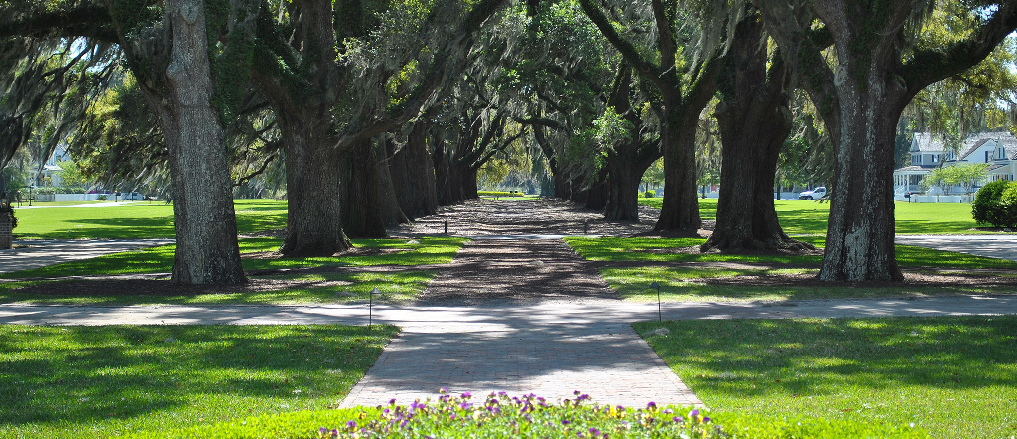
Even though Ford has unparalleled natural beauty, unequaled amenities and timeless architecture that stands up to the top Communities of the world, it was not selling out and was not selling at a pace equal to its competitors!

Slide 9
There was no professional developer. No team of experienced onsite luxury sales experts, no professional builder team program and no marketing director.
With over 50% of Ford for sale, the community was desolate,
and questionable as a place to buy.

Slide 10
As in the day of DPS, Ford must be marketed as a top-level private luxury destination community and, unlike DPS, sales must be focused on buyers who intend to live and enjoy as Residents and Members Ford Plantation’s amazing
beauty and amenities. If a Community has no activity or families to connect with it will fail and appear to be fake or simply a place to invest but never live.

Slide 11
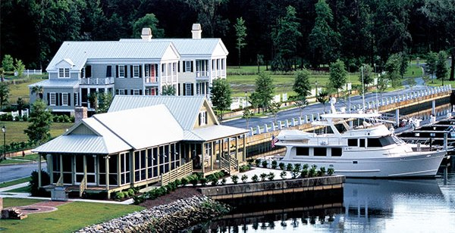
The inventory of homes and lots for sale must be marketed and sold.
Supply and demand must be brought into balance.
Values must begin to increase and sales improve for Ford to be competitive again.
Ignoring all of the volume of current inventory for sale is not an option.

Slide 12
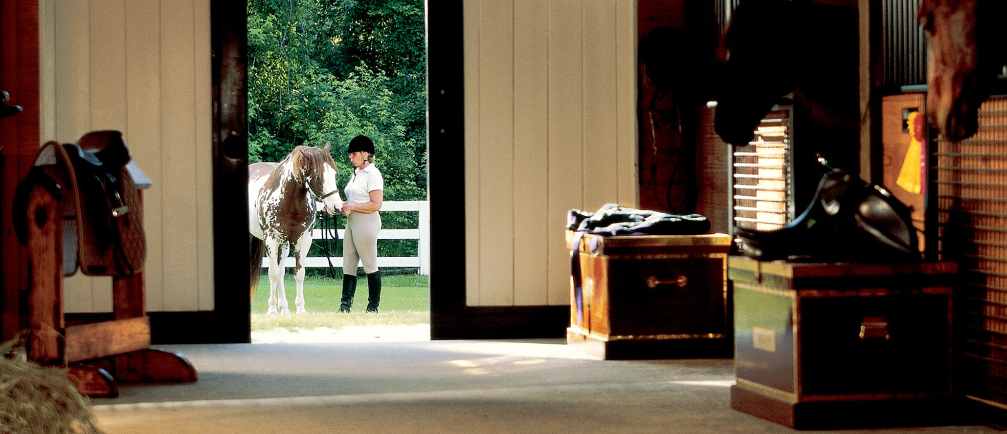
Every touchpoint must perfectly represent the Ford brand.
The Sales Team, Club Staff, Club Programming, Community, Website, Sales Collateral, Sales Gallery, Homes for Sale, Lots for Sale, Memberships, and Discovery Tour Suites and Cottages.

Slide 13
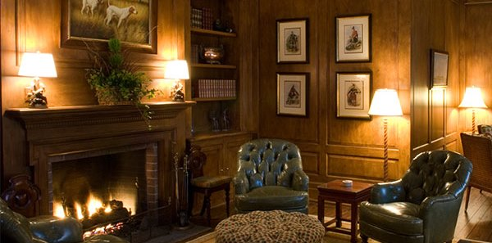
The right Buyers had to be targeted. Bulleted not buckshot.
The campaign must feel like a private invitation, exclusive.
It must reach the right level of Buyer who is in the right frame of mind so marketing dollars work. The appropriate marketing dollars must be budgeted and the right firm brought aboard to guide the process.

Slide 14
The campaign must create a sense of urgency.
This means controlling the inventory.

Slide 15
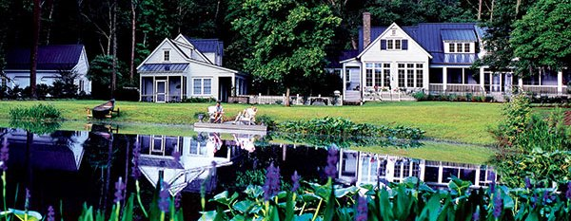
The campaign and sales team must show the Buyers what they want. In addition to adding floor plans that are not offered this means presenting Ford as a place that stands alone, unlike any other and is so valuable and exclusive that only a select few can attain it.
200 not 2,000

Slide 16

The competition has rebuilt their brands and their Clubs.
They have adjusted their marketing to fit an entirely new buyer mind-set.
They know that today’s buyers are more cautious and sophisticated.
They know buyers want what they want and they want it today.
And… most importantly, they have skilled experienced professionals dedicated exclusively to running their projects.

Slide 17
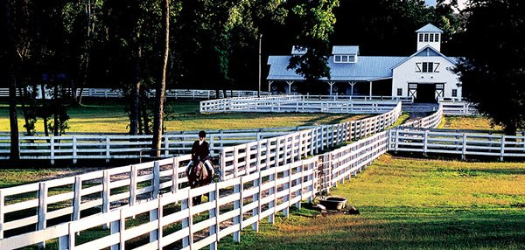
Ford was uncompetitive.
No development team was running the project.
No specific entity or member in Ford has the overall control, time or experience needed to implement and govern the solution.

Slide 18
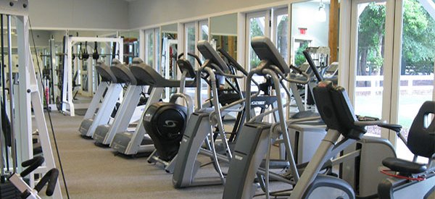
So much lifestyle but so few people enjoying it.

Slide 19
Discerning buyers who will choose the lifestyle of Ford
want the full Club and Community experience with
Members who are engaged – not polarized.

Slide 20

People want people. They want to make memories.
The Community needs life; not just landscape and hardscape.
Southcreek Holdings knows the problems, knows the answers and has the intellectual property as well as the boots on the ground talent to solve the issues at bay and re-launch the Ford brand.

Slide 21
What must happen…
Contract with Southcreek Holdings. We will provide a professional developer, sales director, and marketing director, marketing firm. We will set up an in-house sales operation (one team). Bring all the listings in-house.
Obtain Member & Resident buy in.
Allow the new development team to do their job. Not a GM.
Create a cohesive multi price level Builder Program
Introduce the New Product & Floor Plans needed
Deploy a new PR, Digital & Print Marketing Campaign
Provide a proessional Home Staging firm
Oversee Homesite Clean-up as needed
Amenity Punch-out
And, most importantly insure the creation of
Club Events to re-engage Members!

